Slide 1
Simple Linear Regression

Slide 3
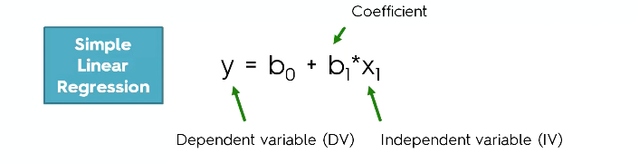
Simple Linear Regression

Slide 4
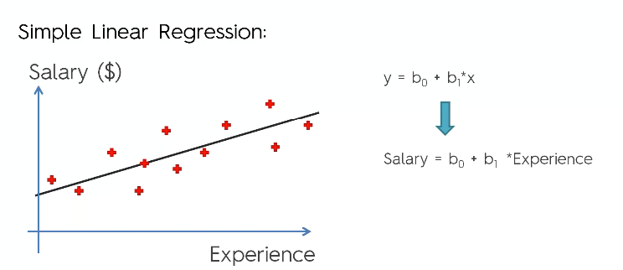
Simple Linear Regression

Slide 5
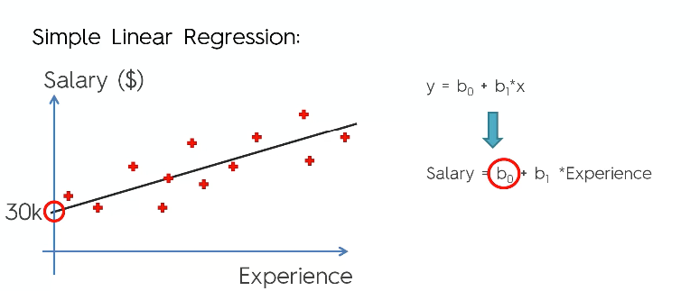
Simple Linear Regression

Slide 6
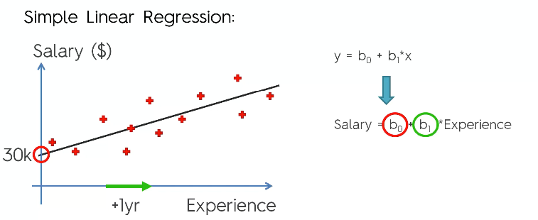
Simple Linear Regression

Slide 7
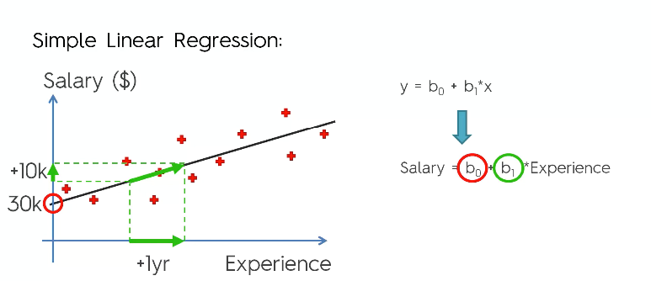
Simple Linear Regression

Slide 8
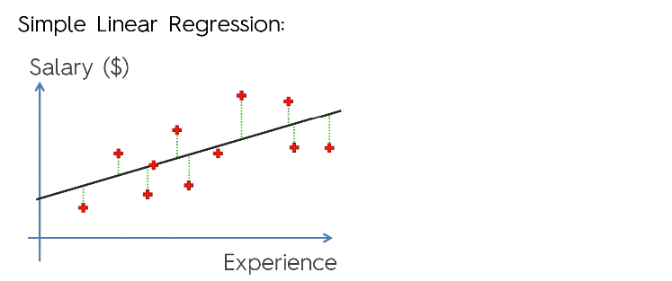
Simple Linear Regression

Slide 9
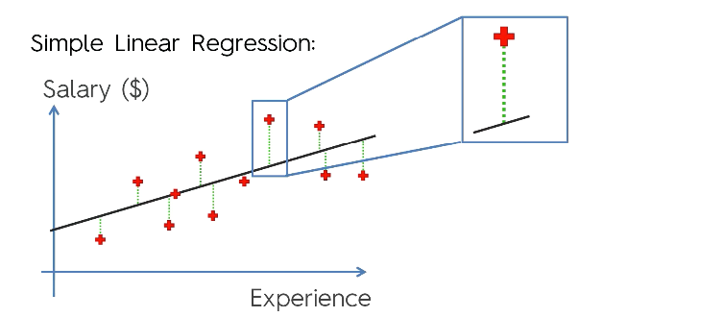
Simple Linear Regression

Slide 10
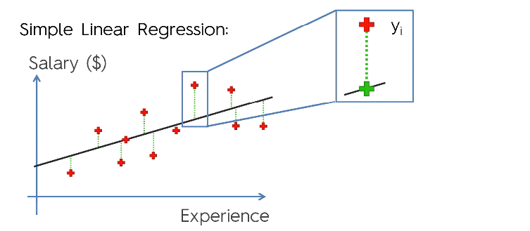
Simple Linear Regression

Slide 11
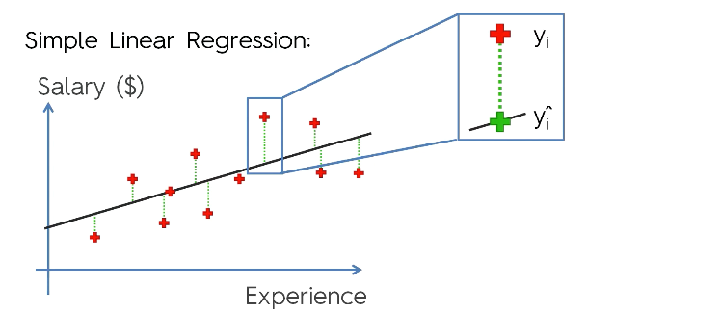
Simple Linear Regression

Slide 12
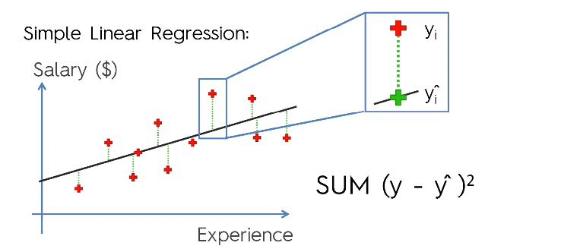
Simple Linear Regression

Slide 13
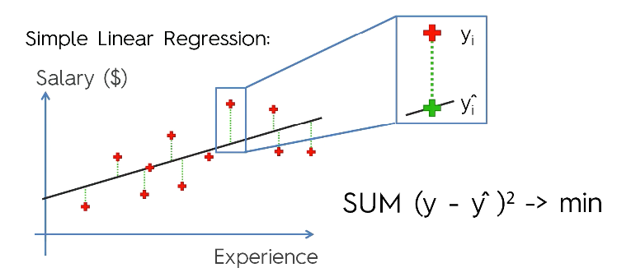
Simple Linear Regression

